Slide 1
Conditionals

Slide 2
The modulus operator
The modulus operator works on integers (and integer expressions) and yields the remainder when the first operand is divided by the second.
In Python, the modulus operator is a percent sign (%).

Slide 3
Example
The syntax is the same as for other operators:
>>> quotient = 7 / 3
>>> print quotient
2
>>> remainder = 7 % 3
>>> print remainder
1
So 7 divided by 3 is 2 with 1 left over.

Slide 4
Uses
Check whether one number is divisible by another if x % y is zero, then x is divisible by y.
you can extract the right-most digit or digits from a number.
For example,
x % 10 yields the right-most digit of x (in base 10). Similarly x % 100 yields the last two digits.

Slide 5
Boolean expressions
A Boolean expression is an expression that is either true or false.
One way to write a Boolean expression is to use the operator ==, which compares two values and produces a Boolean value:
>>> 5 == 5
True
>>> 5 == 6
False
True and False are special values that are built into Python.

Slide 6
Comparison Operators
x != y # x is not equal to y
x > y # x is greater than y
x < y # x is less than y
x >= y # x is greater than or equal to y
x <= y # x is less than or equal to y
NOTE: “= is an assignment operator and == is a comparison operator”. Also, there is no such thing as =< or =>.

Slide 7
Logical operators
There are three logical operators:
        and,
        or
        not
For example, x > 0 and x < 10 is true only if x is greater than 0 and less than 10.
n%2 == 0 or n%3 == 0
not(x > y) is true if (x > y) is false, that is, if x is less than or equal to y.

Slide 8
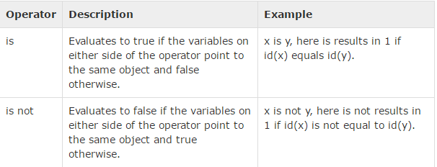
Identity operators
Identity operators compare the memory locations of two objects. There are two Identity operators as explained below

Slide 9
Example
..\..\..\..\Python27\is.py

Slide 10
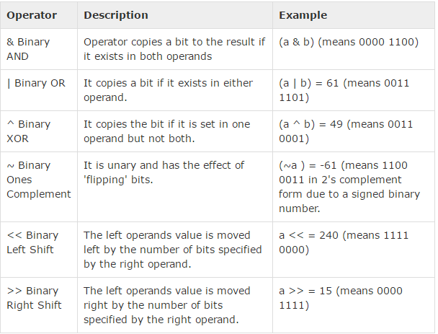
Bitwise Operators

Slide 11
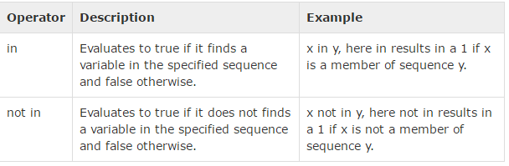
Membership Operators

Slide 12
a = 10
b = 20
list = [1, 2, 3, 4, 5 ];
if ( a in list ):
print "Line 1 - a is available in the given list"
else:
print "Line 1 - a is not available in the given list"

Slide 13
Continue…
Any nonzero number is interpreted as “true."
>>> x = 5
>>> x and 1
1
>>> y = 0
>>> y and 1
0

Slide 14
Conditional Execution
To write useful programs we need the ability to check conditions and change the behaviour of the program accordingly.
Conditional statements give us this ability. The simplest form is the if statement:
if x > 0:
print "x is positive“
The Boolean expression after the if statement is called the condition.

Slide 15
Basic Structure of If Statement
Like other compound statements, the if statement is made up of a header and a block of statements:
HEADER:
FIRST STATEMENT
... BLOCK
LAST STATEMENT

Slide 16
Alternative execution
A second form of the if statement is alternative execution, in which there are two possibilities and the condition determines which one gets executed.
The syntax looks like this:
>>if x%2 == 0:
print x, "is even“
>>else:
print x, "is odd"

Slide 17
Continue….
Since the condition must be true or false, exactly one of the alternatives will be executed. The alternatives are called branches, because they are branches in the flow of execution.

Slide 18
Wrapping of IF-ELSE into one function.
def printParity(x):
if x%2 == 0:
print x, "is even"
else:
print x, "is odd“
For any value of x, printParity displays an appropriate message. When you call it, you can provide any integer expression as an argument.

Slide 19
Example
>>> printParity(17)
17 is odd
>>> y = 17
>>> printParity(y+1)
18 is even

Slide 20
Chained Conditionals
Sometimes there are more than two possibilities and we need more than two branches.
if x < y:
print x, "is less than", y
elif x > y:
print x, "is greater than", y
else:
print x, "and", y, "are equal“
NOTE: There is no limit of the number of elif statements, but the last branch has to be an else statement

Slide 21
Example
if choice == 'A':
functionA()
elif choice == 'B':
functionB()
elif choice == 'C':
functionC()
else:
print "Invalid choice."

Slide 22
Assignment :
“Calculator in Python”
..\..\..\..\Python27\cal.py

Slide 23
Nested conditionals
One conditional can also be nested within another.
if x == y:
print x, "and", y, "are equal"
else:
if x < y:
print x, "is less than", y
else:
print x, "is greater than", y

Slide 24
Avoid Nested If
For example, We can rewrite the following code using a single conditional:
if 0 < x:
if x < 10:
print "x is a positive single digit.“
Better way:
if 0 < x and x < 10:
print "x is a positive single digit."

Slide 25
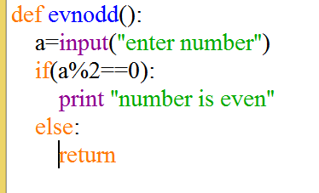
The Return Statement
The return statement allows you to terminate the execution of a function before you reach the end.

Slide 26
ITERATION

Slide 27
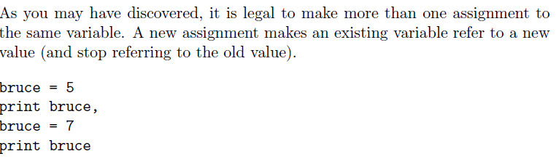
Multiple assignment
Notes:
Output : 5 7

Slide 28
The while statement
Computers are often used to automate repetitive tasks.
Repeating identical or similar tasks without making errors is something that computers do well and people do poorly.

Slide 29
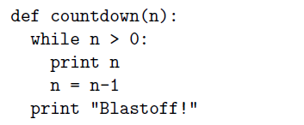
Example

Slide 30
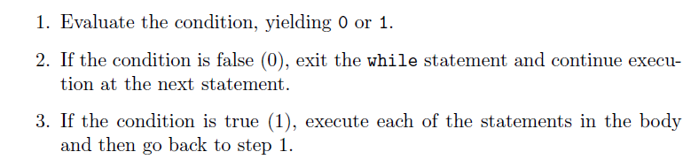
Flow of Execution for WHILE Statement

Slide 31
Program 1
count = 0
while (count < 9):
print 'The count is:', count
count = count + 1
print "Good bye!"

Slide 32
count = 0
while (count < 9):
print 'The count is:', count
count = count + 1
print "Good bye!"
count = 0
while count < 5:
print count, " is less than 5"
count = count + 1
else:
print count, " is not less than 5"

Slide 33
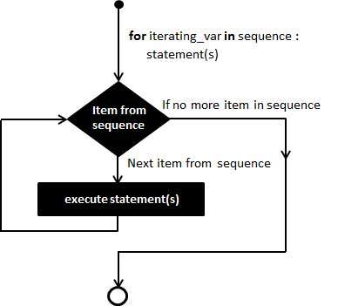
For loop structure
for letter in 'Python':
# First Example
print 'Current Letter :', letter
# second example
fruits = ['banana', 'apple', 'mango']
for fruit in fruits:
print 'Current fruit :', fruit
print "Good bye!"

Slide 34
fruits = ['banana', 'apple', 'mango']
for index in range(len(fruits)): print 'Current fruit :', fruits[index] print "Good bye!"
# display prime no. from 1-20

Slide 35
for num in range(10,20):
for i in range(2,num):
if num%i == 0:
j=num/i
print '%d equals %d * %d' % (num,i,j)
break
else:
print num, 'is a prime number'

Slide 36
Nested loops
i = 2
while(i < 100):
j = 2
while(j <= (i/j)):
if not(i%j): break
j = j + 1
if (j > i/j) : print i, " is prime"
i = i + 1
print "Good bye!"

Slide 37
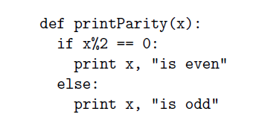
Encapsulation
Encapsulation is the process of wrapping a piece of code in a function, allowing you to take advantage of all the things functions are good for.
Example:

Slide 38
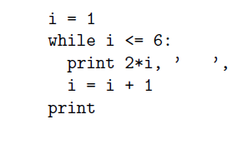
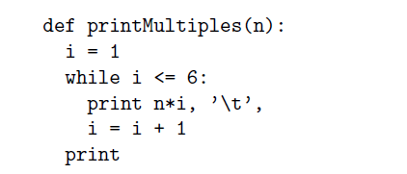
Generalization
Generalization means taking something specific and making it more general, such as printing the multiples of 2 as printing the multiples of any integer.
Specific code
Generalization

Slide 39
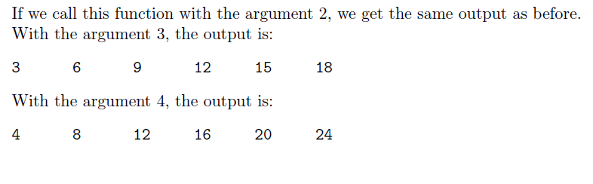
Output of Example

Slide 40
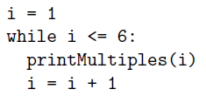
Another Example

Slide 41
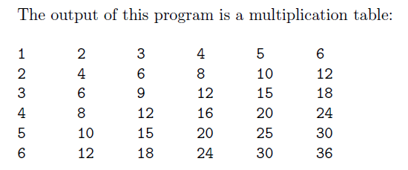
OUTPUT

Slide 42
N=input(‘enter a number’)
i=2
S=0
While(i<n/2)
If(n%i==0)
Print “composite”
S=1
Break
i=i+1
If s==0
Print “prime”

